Slide 1
MODULE 4 – INTRODUCTION TO PERIPHERAL INTERFACING - I

Slide 2
Programmable interrupt controller - 8259

Slide 3
Why 8259?
To interface I/O devices to the microprocessor.
The 8086 has only two interrupt inputs, NMI and INTR. If we use NMI for a power failure interrupt, this leaves only one interrupt input for all other applications.
To overcome these disadvantages, the programmable interrupt controller that is capable of handling number of interrupts is used.
8259 can take care of all the interrupts simultaneously along with their priorities and types.
Intel’s 8259 was compatible with only 8-bit microprocessors but the advanced version of it, 8259A is compatible with 8 as well as 16-bit microprocessors.

Slide 4
FEATURES OF 8259
INTEL 8259 is a single chip programmable interrupt controller which is compatible with 8085, 8086 and 8088 processors.
It is a 28 pin DIP IC with N-Mos technology and requires a single +5V DC supply.
Ability to accept level triggered or edge triggered inputs.
It handles up to eight vectored priority interrupts for the CPU and cascadable for upto 64 vectored priority interrupts without the need of any additional circuitry.
when two 8259s are cascaded through cascade lines the first 8259 will act as master and the second 8259 will act as a slave.

Slide 5
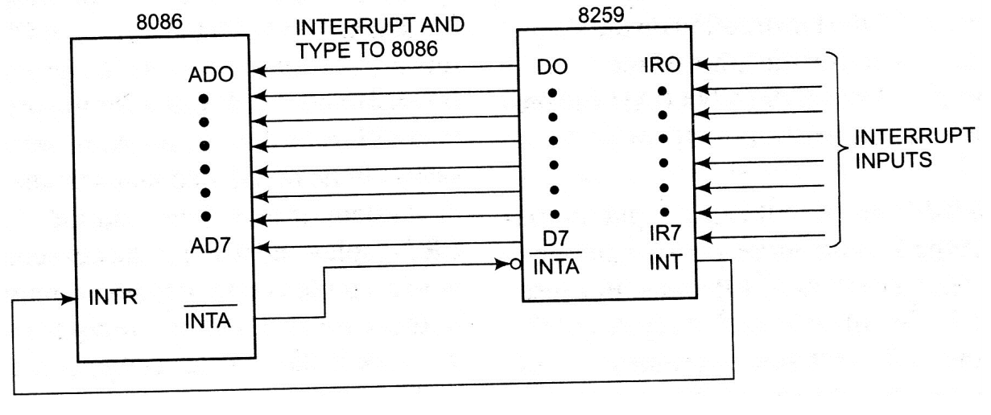
Connection of 8259A with 8086 microprocessor (Single Mode)

Slide 6
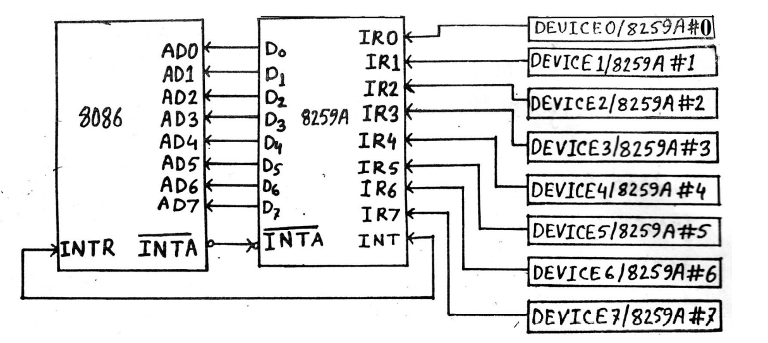
Connection of 8259A with 8086 microprocessor (Cascade Mode)
MASTER
SLAVES
64 Interrupts
The 8259A PIC adds eight vectored priority encoded interrupts to the microprocessor. This controller can be expanded without additional hardware, to accept upto 64 interrupt requests. This require a master 8259A and eight 8259A slaves.

Slide 7
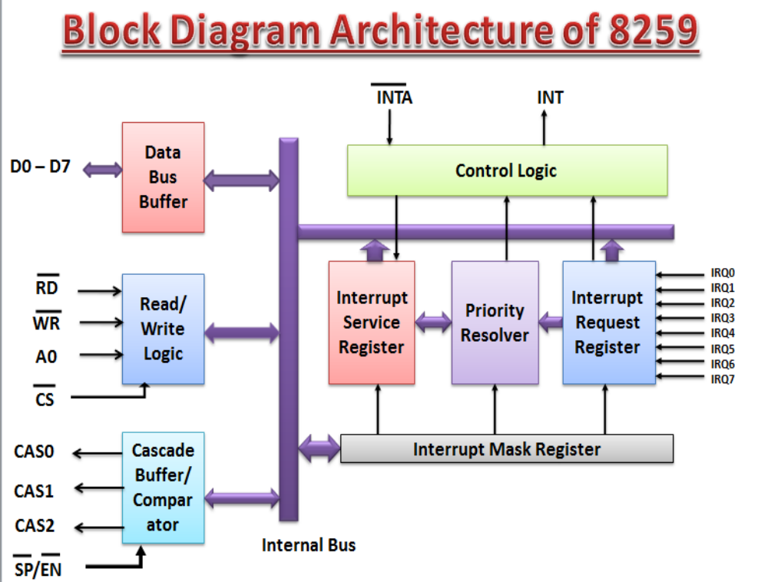
Architecture of 8259A

Slide 8
Functional descriptions
IN Service Register (ISR)
The IN service registers keeps tracks of which interrupt inputs are currently being serviced.
For each input that is currently being serviced the corresponding bit will be set in the in service register.

Slide 9
Interrupt Request Register (IRR)
IRR stores all the interrupt inputs that are requesting service.
Basically, it keeps track of which interrupt inputs are asking for service.
If an interrupt input is unmasked, and has an interrupt signal on it, then the corresponding bit in the IRR will be set.

Slide 10
INTERRUPT MASK REGISTER(IMR)
The IMR stores the bits which mask the interrupt lines. The IMR operates on the IRR.
Masking of higher priority input will not affect the interrupt request lines of lower priority. To unmask any interrupt the corresponding bit is set ‘0’.

Slide 11
PRIORITY RESOLVER
This logic block determines the priorities of the bits set in the IRR.
The highest priority is selected and strobed into the corresponding bit of the ISR during INTA’ pulse.

Slide 12
DATA BUS BUFFER
This 3- state, bidirectional 8-bit buffer is used to interface the 8259A to the system data bus.
Control words and status information are transferred through the data bus buffer.

Slide 13
INTERRUPT CONTROL LOGIC
This unit has two pins. INT (Interrupt) as an output pin and (interrupt acknowledge) INTA’ as an input pin.
The INT is connected to the interrupt pin of the microprocessor unit. Whenever an interrupt is noticed by the CPU, it generates signal.

Slide 14
READ/WRITE CONTROL LOGIC
The function of this block is to accept OUTPUT commands from the CPU.
It contains the initialization command word (ICW) register and operation command word (OCW) register which store the various control formats for device operation.
This function block also allows the status of 8259A to be transferred to the data bus.

Slide 15
CASCADE BUFFER/COMPARATOR
This function blocks stores the IDs of all 8259’s used in the system. The associated 3-I/O pins (CAS0-CAS2) are outputs when 8259A is used a master.
The same pin act as inputs when 8259A is used as a slave. As a master, the 8259A sends the ID of the interrupting slave device onto the cas2-cas0.
The slave thus selected will send its pre-programmed subroutine address onto the data bus during the next one or two consecutive INTA’ Pulse.

Slide 16
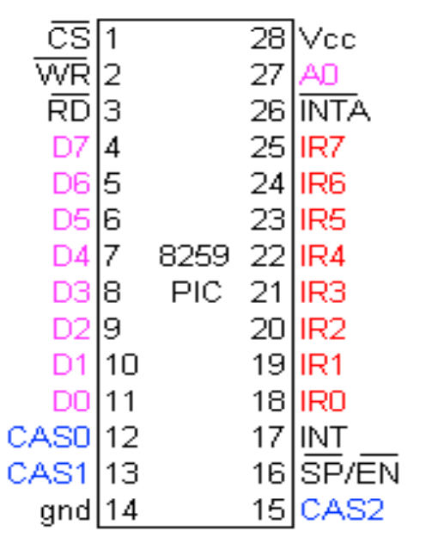
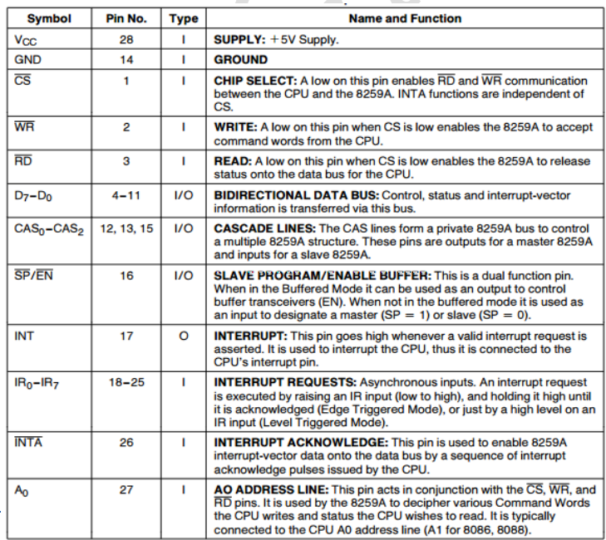
Pin diagram

Slide 17
8259A INTERRUPT OPERATION
Step-1: The IRR of 8259A stores the request.
Step-2: The priority resolver checks 3 registers-
The IRR for interrupt requests. * IMR for masking bits and *the ISR for interrupt request being served.
It resolves the priority and sets the INT high to CPU
Step-3: The CPU acknowledges the interrupt by sending signals in
𝐼𝑁𝑇𝐴’’.
Step-4: After the 𝐼𝑁𝑇𝐴’ is received, the highest priority ISR bit is set to indicate which interrupt level is being served and the corresponding bit in the IRR is reset to indicate that the request for the CALL instruction is placed on the data bus through its D0- D7 pins.

Slide 18
CONTD
Step-5: When CPU decodes the CALL instruction, it places two more
𝐼𝑁𝑇𝐴 signals’ on the data bus.
Step-6:
When the 8259A receives the second 𝐼𝑁𝑇𝐴, it places the low-order byte of the CALL address on the data bus.
At the 3rd 𝐼𝑁𝑇𝐴, it places the high order byte on the data bus.
The CALL address is the vector memory location for the interrupt, this address is placed in the control register during the initialization.

Slide 19
CONTD
Step-7:
During the 3rd 𝐼𝑁𝑇𝐴 pulse, the ISR bit is reset either automatically (Automatic-End-of Interrupt-AEOI) or by a command word that must be issued at the end of the service routine (End of Interrupt-EOI).
Step-8:
The program sequence is transferred to the memory location specified by the CALL instruction

Slide 20
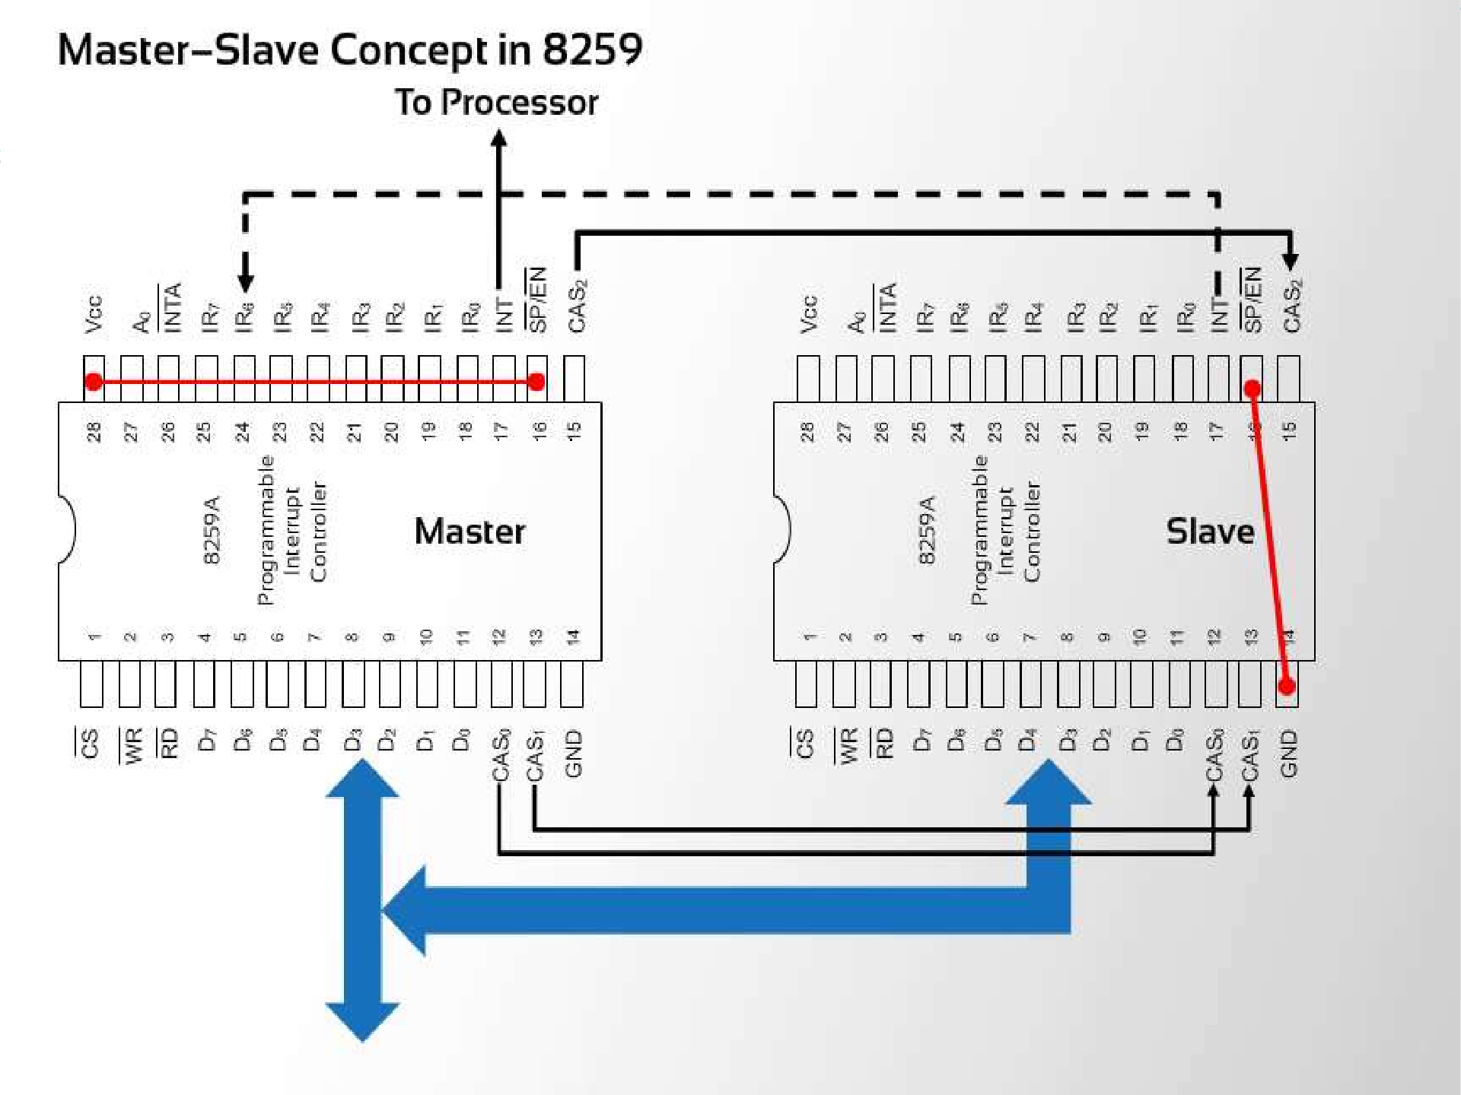




Slide 21
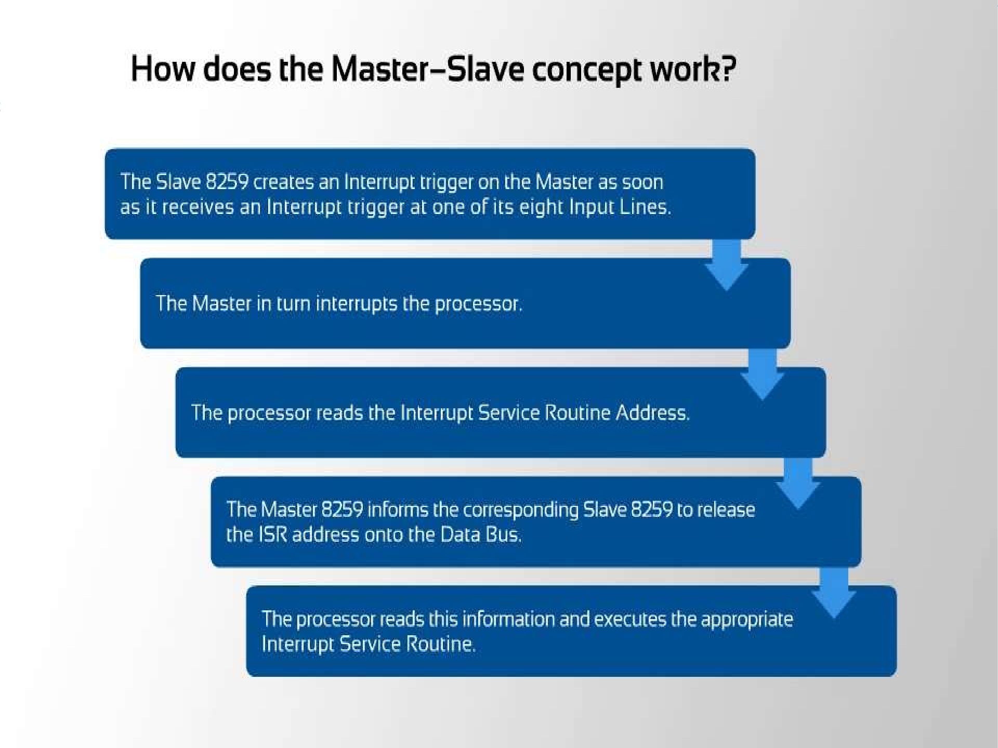


Slide 22
Programming the 8259A
The 8259A is programmed by initialization and operation command words.
Initialization command words (ICWs) are programmed before the 8259A is able to function in the system and dictate the basic operation of 8259A.
Operation command word (OCWs) are programmed during the normal course of operation. The OCWs control the operation of the 8259A.

Slide 23
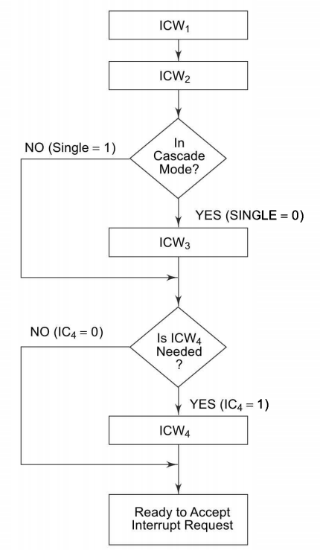
INITIALIZATION FLOWCHART
There are four Initialization Command Words for the 8259A that are selected with the help of logic level of A0 pin.
When the 8259A is first powered up, it must be sent ICW1, ICW2 and ICW4.
If single 8259A used in system, ICW1, ICW2 and ICW4 must be programmed.
If cascade mode is used in system, then all four ICWs must be programmed.

Slide 24
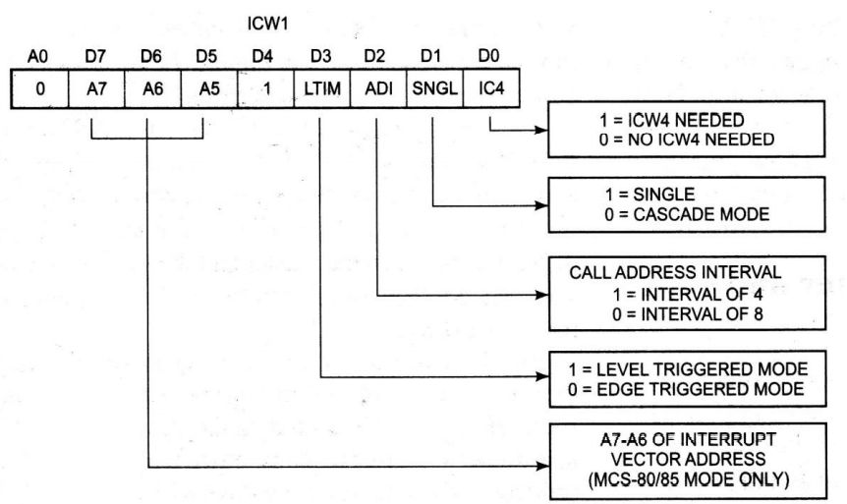
ICW1:
To program this ICW for 8086 ,we place a logic 1 in bit IC4.
Bits D7, D6 , D5and D2 are don’t care for microprocessor operation and only apply to the 8259A when used with an 8-bit 8085 microprocessor.
This ICW selects single or cascade operation by programming the SNGL bit.
If cascade operation is selected, we must also program ICW3.
The LTIM bit determines whether the interrupt request inputs are positive edge triggered or level-triggered.

Slide 25
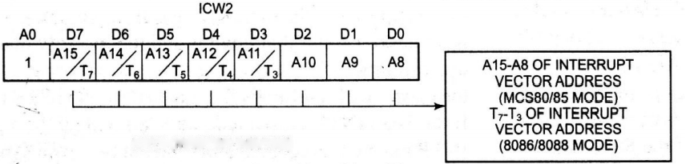
ICW2
ICW2: Selects the vector number used with the interrupt request inputs.
For example, if we decide to program the 8259A so that it functions at vector locations 08H-0FH, we place a 08H into this command word.

Slide 26
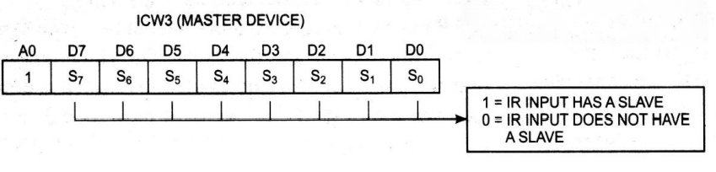
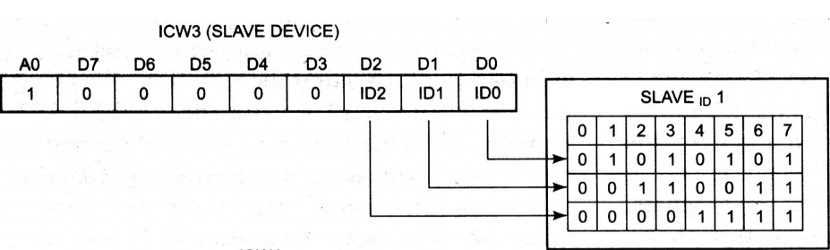
ICW3
ICW3 (Master Device): Only used when ICW1 indicates that the system is operated in cascade mode. ICW3 (for master device) indicates where the slave is connected to the master. Suppose, we have two slaves connected to a master using IR0 and IR1. The master is programmed with an ICW3 of 03H.
ICW3 (Slave Device): ICW3 (for slave device) indicates where the slave is connected to the master. Suppose, we have two slaves connected to a master using IR0 and IR1. One slave is programmed with an ICW3 of 01H and other with an ICW3 of 02H.

Slide 27
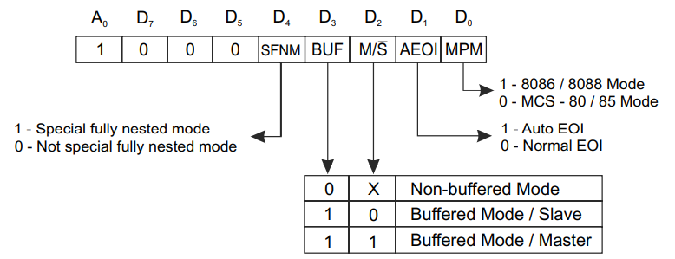
ICW4
The bit D0 must be logic 1 to select operation with the 8086 microprocessor.
SFNM (Special Fully-Nested Mode):
If SFNM=1, then it selects the special fully-nested mode of operation for the 8259A. At that time, this allows the highest-priority interrupt request from a slave to be recognized by the master while is processing another interrupt from a slave.
Normally (if SFNM=0), only one interrupt request is processed at a time and others are ignored until the process is complete.

Slide 28
ICW4-CONTD
BUF and M/S’:
Buffered and master slave are used together to select buffered operation or non buffered operation for the 8259A as master or a slave.
AEOI (Automatic end of interrupt):
Selects automation or normal end of interrupt.
The EOI commands of OCW2 are used only if the AEOI mode is selected by ICW4.
If AEOI is selected, the interrupt automatically resets the interrupt request bit and does not modify priority.
This is the preferred mode of operation for the 8259A and reduces the length of the interrupt service procedure.

Slide 29
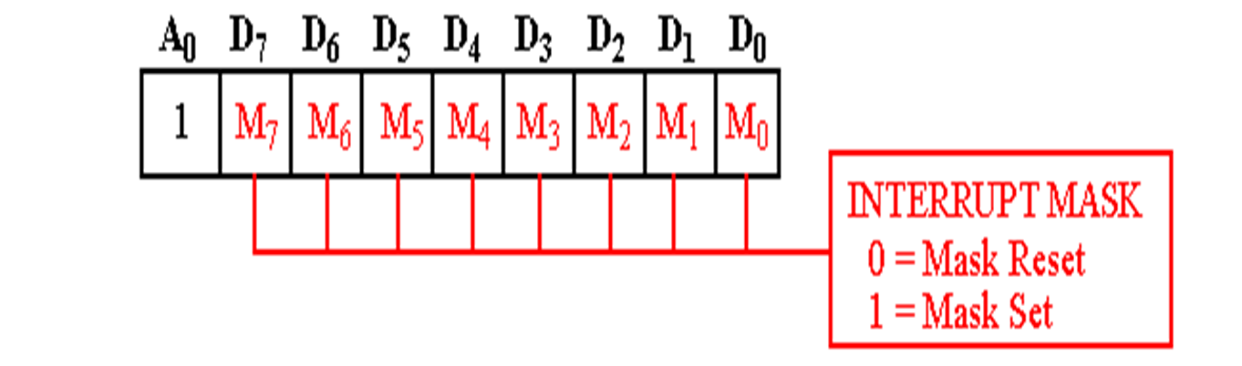
OPERATION COMMAND WORDS(OCWs)
The operational command words (OCWs) are used to direct the operation of the 8259A once it is programmed with ICW. The ICWs are selected when A0= 0 level, expect for OCW1, which is selected for A0=1.
OCW1:
Used to set and read the interrupt mask register.
When a mask bit is set, it will turn off (mask) the corresponding interrupt input. The mask register is read when OCW1 is read.
Because the state of mask bits is unknown when the 8259A is first initialize, OCW1 must be programmed after programming the ICW upon initialization.

Slide 30
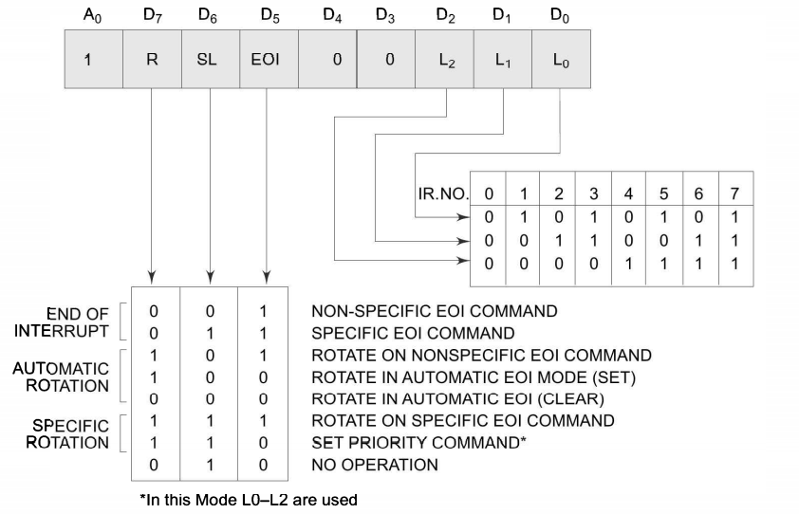
OCW2
Is programmed only when the AEOI mode is not selected for the 8259A.
In this case, this OCW selects how the 8259A responds to an interrupt

Slide 31
OCW2-CONTD
The modes are listed as follow-
Non specific End-of-Interrupt:(Fully Nested mode)
This is an OUT instruction by the CPU to 8259A.
A command sent by the interrupt service procedure to signal the end of the interrupt.
When this command is sent to the 8259A, it resets the highest priority ISR bit.
This allows the interrupt to take action again or a lower priority interrupt to take effect.
Specific EOI Command:
A command that allows a specific interrupt request to be reset.
The exact position is determined with bits L2-L0 of OCW2.

Slide 32
OCW2-CONTD
Rotate on Nonspecific EOI Command
A command that functions exactly like the Nonspecific End-of-Interrupt command, except that it rotates the interrupt priorities after resetting the interrupt status register bit.
The level reset by this command becomes the lowest-priority interrupt.
For example, if IR4 was just received by this command, it becomes the lowest-priority interrupt input and IR5 becomes the highest priority.

Slide 33
OCW2-CONTD
Rotate on automatic EOI:
Rotate on automatic EOI mode(Set)
Once this command is sent to PIC, it will automatically cause the PIC to perform a rotate on non-specific EOI command during INTA bus cycles. This command must only be sent to the 8259A once if this mode is desired.
Rotate on automatic EOI mode(Clear)
To disable the rotate on automatic EOI mode, this clear command should sent to 8259A.
Rotate on specific EOI:
Functions as the specific EOI, except that it selects rotating priority.
Set priority
Allows the programmer to set the lowest priority interrupt input using the L2- L0 bits, thus fixing all other priority.

Slide 34
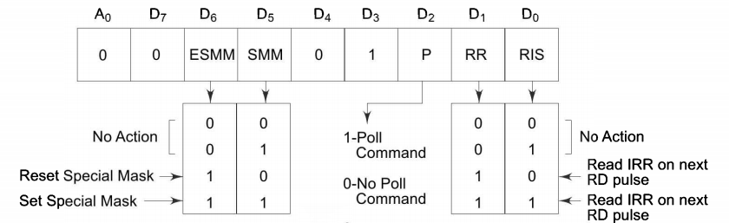
OCW3
Selects the register to be read, the operation of the special mask register and the poll command.
Reading register
Both the interrupt request register (IRR) and in-service register (ISR) are read by programming OCW3.
[Note- Interrupt mask register (IMR) is read through OCW1, to read the IMR , A0=1, to read IRR or ISR, A0 = 0].
Bit position D0 and D1 of OCW3 select which register (IRR or ISR) is read.

Slide 35
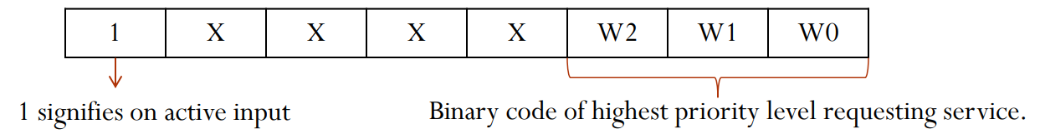
OCW3-CONTD
Poll Mode:
If polling is selected, the P-bit must be set and then output to the 8259A. The next read operation would read the poll word.
The rightmost three bits of the poll word indicate the active interrupt request with the highest priority.
The leftmost bit indicates whether there is an interrupt and must be checked to determine whether the right three bit contains valid information.

Slide 36
OCW3-CONTD
Special Mask Mode
As we have seen, the PIC normally inhibits interrupt requests of equal or lower priority than that of currently in service.
In the special mask mode, this is altered to allow interrupts on all inputs except the input currently in service.

Slide 37



